Slide 1
What is Science?

Slide 2
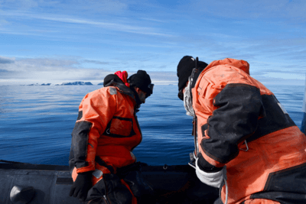
By the end of this lesson you should be able to:
Define science.
Define data.
Define experiments.
Identify the five main types of scientific study.

Slide 3

What exactly is science?
You've probably heard about science before.
It's mentioned on the news when discussing technology or public health. You can also find some pretty cool science articles about things like unusual animals and tiny machines!

Slide 4

Science is derived from the Latin word scientia, which means knowledge.
This is fitting, since science is the practice of systematically collecting and generating knowledge by studying the world around us.
We can use this knowledge to answer questions, figure out how things work, solve problems and make awesome technologies.

Slide 5
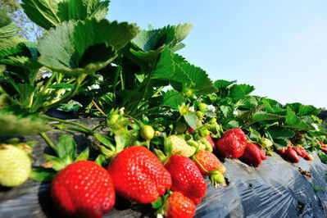
In science, we are constantly collecting and analysing information.
This information is called data.
For example, imagine you have a strawberry patch that is being raided by wild animals. You want to know what type of animals are doing this, so that you can build an enclosure to keep them out.
To answer this question, you can watch the strawberry patch and record all the different animals that visit it. This list of animals is your data.

Slide 6
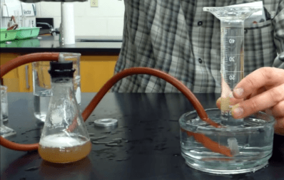
Science often uses experiments to collect data.
Experiments are controlled situations created by the scientist. In an experiment, everything is kept the same except for the one thing you are studying. This one thing is changed and the effect of this change is measured.

Slide 7
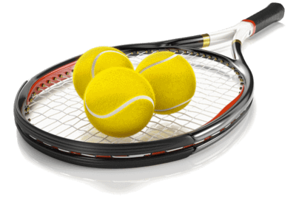
For example, you might play tennis and want to know which company makes the bounciest tennis balls.
You can test this using an experiment, in which you drop different brands of tennis balls from a certain height and see how high they bounce.
The height they are dropped from is kept the same, as is the type of surface they are dropped onto. The only thing that is changed is the brand of the tennis ball.
By controlling these factors, you can test how the brand of a tennis ball affects its bounce.

Slide 8
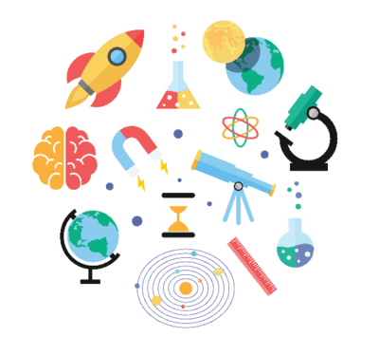
Let's review what we've learnt so far about science.
In science, we study the world around us in order to collect and generate knowledge. This involves collecting information, which we call data. One way data can be collected is through controlled studies called experiments.

Slide 9
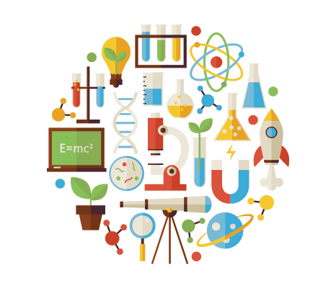
Science can be divided into different categories depending on what is being studied.
We are going to briefly cover five types of science: biology, physics, chemistry, Earth science and space science.

Slide 10
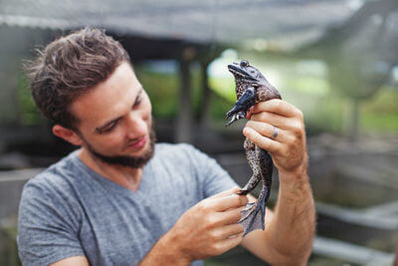
Biology is the study of living things, such as plants, animals and fungi.
A biologist might ask questions like the ones below:
"Where do plants get their water from?"
"What food does this animal eat?"
"How does this chemical affect insects?"

Slide 11
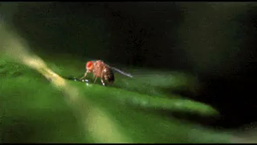
In biological sciences, we often learn how to classify living things into groups, and what ecosystems are and how they work.

Slide 12

Chemistry is the study of substances, such as different chemicals and mixtures.
Below are some questions a chemist might ask:
"What materials are in this mixture?"
"Is this metal magnetic?"
"What effect does this chemical have on people?"

Slide 13
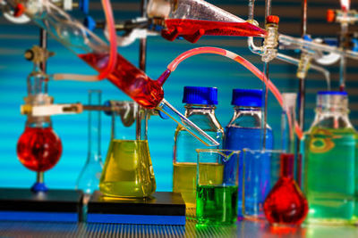
For example, in chemistry we can learn about different types of mixtures and how the substances inside them can be separated.

Slide 14

Physics is the study of energy and how things move.
A physicist might ask questions like the ones below:
"How much force does it take to stop a moving object?"
"How strong is gravity on Earth?"
"What will happen if a speeding car hits a brick wall?"

Slide 15
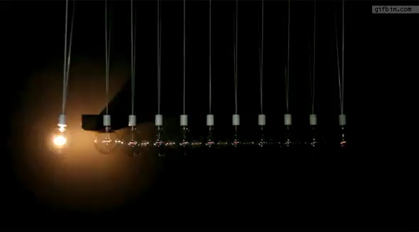
Often in physics we study different types of forces and how to calculate their size.

Slide 16
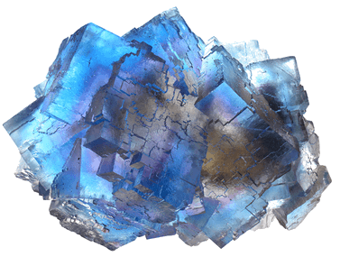
Earth science is exactly what it sounds like: the study of the Earth!
This includes things like how water flows from one place to another or how lava erupts from volcanoes. Someone who studies Earth science may ask questions like the ones below:
"How fast is the ice receding in Antarctica?"
"How do seismic waves travel through different substances?"
"What materials are rocks in different parts of New Zealand made of?"

Slide 17
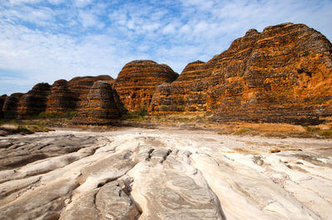
Earth scientists often focus on import things that affect all of us, such as resources and the water cycle.

Slide 18
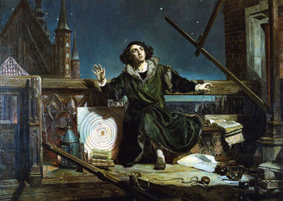
Space science, also known as astronomy, is the study of outer space!
An astronomer studies things like stars, planets, comets and moons. They might ask questions like the ones below:
"How many stars are in our solar system?"
"What materials can you find on comets?"
"Does Mars contain water?"

Slide 19
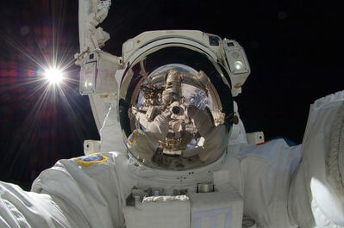
Most space scientists do their study on Earth, looking through telescopes.
However, some venture into space to do their research and gather data to bring back to Earth.
We call them astronauts.

Slide 20
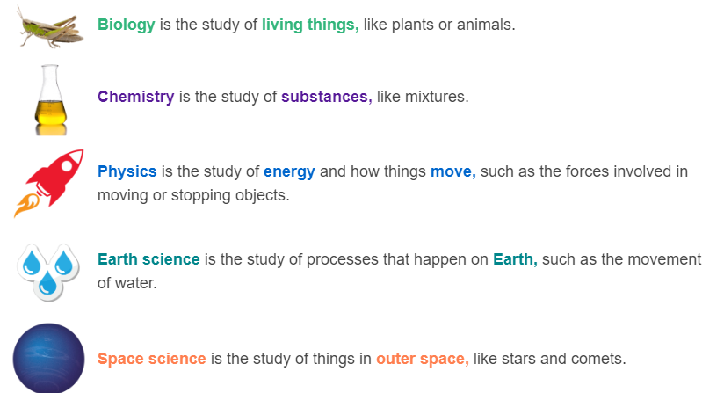
Let's review the five different types of sciences we have covered.

